Slide 1
Introduction to COMP1753 Programming Foundations
Chris Walshaw
Computing & Information Systems
University of Greenwich

Slide 2
Contact information
Name: Chris Walshaw
Email: c.walshaw@gre.ac.uk
please use your University email account
Tel: 020 8331 8142
but best to use email
Office: Queen Mary 234
Office hours for term 1:
Mondays 3-4pm

Slide 3
Lecture Objectives
Introduction to COMP1753
course structure / assessment
attendance / conduct / survival
Introduction to programming
programming / syntax / languages
Python / IDLE
Some examples in Python
Hello World!
examples from later in the course
Turtle graphics

Slide 4
Programming courses
Term 1: COMP1753 Python
1½ hour lecture (Mondays, 12 – 1.40ish)
should give you time to get to 2pm labs on campus
1 hour lab (Mondays, 2-3pm or 3-4pm or 4-5pm)
sorry if you have a gap!
Assessment: exam in January
Term 2: COMP1752 Java
In term 2 you will progress to COMP1752 Object Oriented Programming (Java)
your lecture / tutorial times may depend on your exam mark for COMP1753

Slide 5
COMP1753 Assessment
Exam
Sometime in week commencing 7th January 2019 – do not miss it!!
Worth 100% of your COMP1753 marks
20 questions
multiple choice
open book – you have access to a computer and the web, your lecture notes, your logbook, textbooks, etc
About learned programming skills rather than memory
you should easily pass the exam if you have made a good attempt at all the tutorial work (including reviewing & retrying questions you couldn’t do)

Slide 6
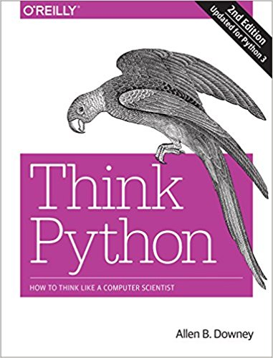
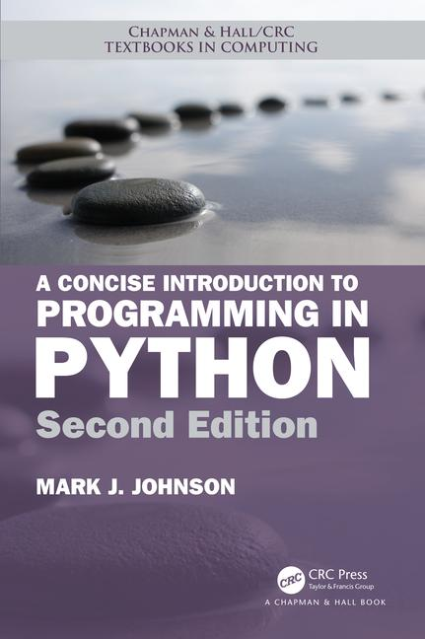
Textbooks for COMP1753
Think Python: How to think like a Computer Scientist (2e), Allen Downey, O’Reilly, 2015
downloadable pdf available for free(!) at https://greenteapress.com/wp/think-python-2e/
A Concise Introduction to Programming in Python, Mark Johnson, CRC Press, 2018
Both books are a good introduction to Python, although not essential, and go far beyond what we shall cover in the course

Slide 7
Attendance
You will need to sign in at the lecture and each lab session by touching your Gateway card against the card reader
in some labs the card reader is attached to the tutor’s computer at the front of the room
in some labs your tutor will be carrying a card reader
Your personal tutor will contact you if you are not attending regularly

Slide 8
Your conduct
Remember, you are no longer at school!
You chose to be here this morning and nobody is forcing you to stay
In fact, you are paying (quite a lot) to be here
unless have rich parents or an enlightened government
So … listen and learn

Slide 9
In lectures
In a lecture theatre (especially a big one like this which holds over 300 students) I can’t necessarily identify who is talking
Personally I don’t really mind if you would rather talk than listen …
you are paying to be here
… but you will be disturbing everyone around who does want to listen
and they are paying to be here too
… and I am not going to compete with you

Slide 10
In summary
If students are talking, I will stop
and that wastes everyone’s money
If someone near to you is talking or disturbing you, tell them to shut up
If you would rather talk than listen, please go and talk somewhere else … the café, the park, the pub, …

Slide 11
On the other hand
University is a great opportunity
you get a chance to study something that interests you
you are likely to make life-long friends
you are likely to significantly enhance your earning potential (especially as computer programmer!)
So enjoy yourself and make the most of it

Slide 12
How to survive this course (1)
This course is not about memorising facts
However, the course is about
practice (makes perfect)
more practice
even more practice
and understanding
So, it is essential to
listen well in lectures
work through the tutorial exercises each week - do them in your own time if you cannot complete them in the lab
keep your logbook up to date – you can use it in the exam
You don’t need to submit your solutions – if you want feedback on your tutorial work or need help, just ask your tutor in the next COMP1753 lab

Slide 13
Your logbook
A logbook is useful for recording
stuff that didn’t work or things that were hard to understand
stuff that worked really well and how you did it
ideas and discoveries of your own
complicated procedures
straightforward procedures that you only do occasionally
if your hard disk crashed would you know which software you had installed and how you installed it?
dates that you did something
if some of your own software stopped working after a modification, would you know when the last stable backup was?

Slide 14
Your COMP1753 logbook
Since you will be working with lots of Python examples, it makes sense to record
(major) changes you made to programs you were given
things that didn’t work – if something you try causes the program to crash, make a note so you don’t do it again!
When pasting code into the logbook you can highlight the important bits in a number of ways
boldface, highlighting, source code comments, Word comments, callouts, ...
The logbook is for your own benefit (e.g. in the exam)
it is not marked (in COMP1753 – other courses may differ)
make sure it is written to be as helpful to you as possible!

Slide 15
How to survive this course (2)
In short
Listen & learn
Complete the tutorial work
ask for help if you are stuck
Write up a log book
Pass the exam (100%) in January
Program, program, program

Slide 16
How to survive this course (3)
Above all develop a curiosity about how programs work and an eagerness to mess around with them
Your first response on being given an unfamiliar program should not be
Oh ****! I have no idea what this does. I don’t know what to do with it.
… but rather
Mmm! I wonder how this works. I wonder what I can do to improve/fix it.
Remember … provided you have a recent backup … it doesn’t matter how often you break a program, you can always go back to the previous working version

Slide 17
Backup
If you are carrying all your work around on a memory stick or even a laptop, what will you do when it crashes or gets lost?
at this University, and probably all the others, lost memory sticks are not accepted as an excuse for late/lost work
Backup, backup, backup!!!
You should get into the habit of backing up your work securely and regularly
at the end of each session (lab, self-study, …)
after you have successfully implemented or fixed something
Your G: drive is a secure storage location

Slide 18
What is computer programming?
Computer programming is the science (and art) of writing computer programs
Notice the confusing and illogical spelling
you are studying a degree programme (e.g. BSc Computer Science, BSc Business Information Technology, BEng Software Engineering, …)
but you will be writing a computer program
when you do this, you will be programming (and not programing)

Slide 19
What is a computer program?
A computer program is a set of instructions that tell a computer what to do
everything a computer does is controlled by a program
Some well-known examples of programs:
A web browser (like Firefox or Chrome) is a computer program that can be used to view web pages on the internet
An office suite (like Microsoft Office) is a collection of computer programs that can be used to write documents
A video game is a computer program
A cash machine (ATM) is controlled by a computer program
Computer programs are often referred to as code and programming is sometimes called coding
A computer program is written in a programming language

Slide 20
What is a programming language?
A programming language is a type of written language that tells computers what to do
There are many different programming languages: e.g. JavaScript, Java, C, C++, C#, Objective-C, Visual basic (VB), Python, …
Each language has its own keywords, grammar, punctuation and syntax
although several languages now look quite similar (JavaScript, Java, C, C++, C#, …)

Slide 21
What is syntax?
Definition:
(generally) the arrangement of words and phrases to create well-formed sentences in a language
(more specifically) the structure of statements in a computer programming language
However,
in English the syntax is fairly flexible
the syntax is fairly flexible in English
the syntax in English is fairly flexible
in the English syntax is flexible fairly

Slide 22
Programming problems
In programming syntax is very strict
if you get it wrong, the computer won’t know what you mean
And sometimes in English too
computer get if it know mean the what won’t wrong you
This is why beginners sometimes find programming hard
they in the wrong order get the commands
and sum times they miss spelt the wurdz

Slide 23
What is Python?
Python is a general purpose programming language.
so you can use Python to write code for any pretty much any programming task
Large organizations that use Python include Wikipedia, Google, Yahoo!, CERN, NASA, Facebook, Amazon & Instagram.
Python is particularly popular for
scientific computing
data science
machine learning / artificial intelligence
natural language processing

Slide 24
What is Python (1)?
Python is an interpreted language rather than a compiled language
means that python code is translated and executed by another program (a Python interpreter) one statement at a time
in a compiled language, the entire source code is compiled and then executed altogether
that probably doesn’t mean anything currently, but in term 2 you will see that Java is a compiled language

Slide 25
What is Python (2)?
Python is an object-oriented programming language
object-oriented programming is a powerful tool for developing reusable software
In COMP1753 Programming Foundations we will just cover the basics of programming
In term 2, in COMP1752 Object-Oriented Programming you will learn much more about objects and classes

Slide 26
Installing Python
You can download and install Python from https://www.python.org/
versions for PCs, Macs & other platforms
It comes with its own development environment called IDLE
stands for Integrated Development and Learning Environment
includes smart code editor, the Python shell & an integrated debugger

Slide 27
Other options
You could also write Python in a simple text editor like NotePad (very basic) or NotePad++ (better) and run it from the Windows/MacOS command window
but why would you do that?
You can create an account at PythonAnywhere.com
this site allows you to create, edit and run Python programs from your web browser
your programs are stored in the cloud, so accessible from any web browser
There are other, more sophisticated, development environments
we will look at another one (pycharm) later in the term

Slide 28
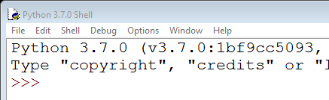
What is the Python shell?
The Python shell is the most basic way of interacting with Python
It provides a command prompt >>> where you can type in Python commands
You can also use it to run Python programs

Slide 29
First example
Every time a programmer starts with a new language it is traditional to write a very basic example to check that everything is configured correctly
Typically the first example just outputs the words “Hello world!”
In fact, in Python we don’t even need to write a program (.py file), we can just type Python commands directly into the shell
type the command at the prompt >>>

Slide 30
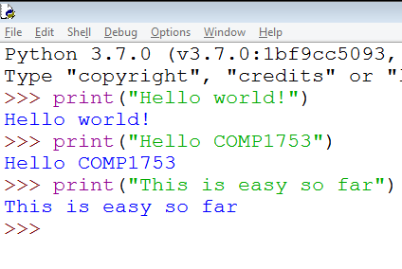
Hello world!

Slide 31
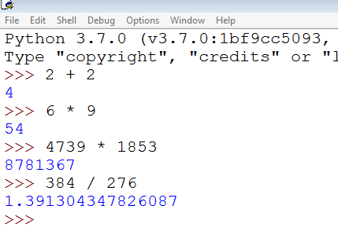
Calculator
You can also use the Python shell as a (quite advanced) calculator

Slide 32
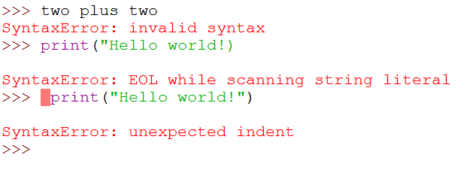
However …
… the Python shell only understands correctly written Python commands
Python can’t speak English
there’s only one double quote "
in Python, whitespace (blank spaces, tabs, etc) is meaningful … more details later

Slide 33
Saving your work
It is not very sophisticated to type Python directly into a shell
when you log off, all your work will be lost!
Instead you should will write your programs in Python (.py) files
But make sure you keep them organised
this course alone will involve over 100 examples and around 60 tutorial exercises

Slide 34
Python examples
Each week you can download a zip file from Moodle containing this week’s lecture notes, tutorial sheet and examples
http://moodlecurrent.gre.ac.uk/my/ > COMP1753
In the labs, right click on the zip file and select 7 Zip > Extract Here
on your own computer you may need to use something else
Each week’s folder contains some .py files – these are Python programs!

Slide 35
01HelloWorld.py
You can run the program by double clicking but it will just start up a shell, run the code and close the shell immediately
you will not be able to read what it says
we will fix this next week
Instead open it in IDLE
start up IDLE, select File > Open… (Ctrl+O) and browse to the folder
alternatively right-click on the .py file and select “Edit with IDLE”
Run by selecting “Run > Run Module” or pressing F5

Slide 36
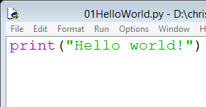
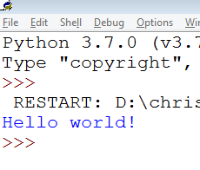
Open a file and run it (F5)
hit F5 or Run > Run Module

Slide 37
So far so good
There are a few more examples in this week’s download to give a flavour of what else we will be able to achieve later on in the course – demo
text analysis: Lorem examples
file management: File examples
image processing: Image filter example

Slide 38
Turtle graphics
For the rest of the lecture we will look at some basic examples using Turtle graphics
The Turtle graphics module comes built in to Python and allows you to create some really intricate 2D graphics and games
IDLE even has a Turtle demo (“Help > Turtle Demo”), e.g.
bytedesign (fancy design)
sorting_animate (animated sorting algorithms)
wikipedia (fancy animated design, but only ~50 lines of code!)

Slide 39
Yin-Yang
Let’s copy the Yin-Yang demo into IDLE
to copy, click in the code window, hit Ctrl+A (select all) and Ctrl+C (copy)
then in IDLE hit Ctrl+N (new file) and Ctrl+V (paste)
these keyboard shortcuts should be familiar from other programs like Word – if they are not, get used to them – they will save you a LOT of time if you work regularly with computers
Now run it (F5)
IDLE will ask you to save the file first – choose a suitable name like yinyang

Slide 40
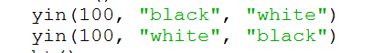
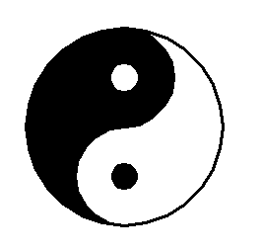
Modifying the code
We haven’t yet found out how Turtle works, but there are some easy changes we can make … what are they?
that’s right – the radius and the colours
Let’s change the radius to 100
and now to 50

Slide 41
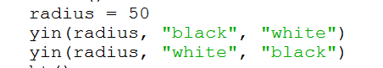
Modifying the code
Hmm … every time we want to do this we have to make two identical changes
if they are not identical it doesn’t work properly
How about if we stored the new value somewhere and then used it … like this
these values need to be identical

Slide 42
Variables
Now we only need to make one change (to radius)
No danger of forgetting to update the values everywhere
and in a complicated program there maybe hundreds of places where a value is reused
In our new version, radius is a variable
even though, for the moment, it doesn’t change when the program is run
lots more about variables next week

Slide 43
Turtle principles
Turtle programs can be very complex but are built of simple commands
Turtle works by moving a pen (called the turtle) around the screen
forward(100) – move forward 100 units
left(90) – turn left through 90°
And that’s enough to draw a square
see 08Turtle_square.py

Slide 44
Pen up / down
If you want to move to another location without creating a line, just lift the pen up and then put it down when you want to start drawing again, e.g.
penup()
forward(100)
pendown()
We can now create a square with no top
see 09Turtle_squareNoTop.py

Slide 45
More commands
Can move directly to a location, e.g.
goto(100, 200) – move to the location x = 100, y = 200 (where x = 0, y = 0 is the centre of the screen)
Can fill the area inside the lines you have drawn, e.g.
fillcolor("red")
begin_fill()
…
end_fill()
And that’s enough to draw a bow tie shape
see 10Turtle_bowtie

Slide 46
Summary
We have looked at quite a lot today
Introduction to COMP1753
course structure / assessment
attendance / conduct / survival
Introduction to programming
programming / syntax / languages
Python / IDLE
Some examples in Python
Hello World!
examples from later in the course
Turtle graphics

Slide 47
… but the most important things to remember are …
Program, program, program
Backup, backup, backup!!!
Above all develop a curiosity about how programs work and an eagerness to mess around with them

